Slide 1
Optimal quantitative easing and tightening by Richard Harrison
Discussion by Dominik Thaler, ECB
Views are my own and do not represent the ECB or Eurosystem.

Slide 2
This paper: The model
Introduces a portfolio rebalancing channel into the 3 equation NKM
Assumption: private sector has preferences for maturity (composition + stability)
Linearizes to
2nd order approximation of welfare
Phillipscurve
IS curve
Policy stance
Nominal rate
QE
QE stock QE flow

Slide 3
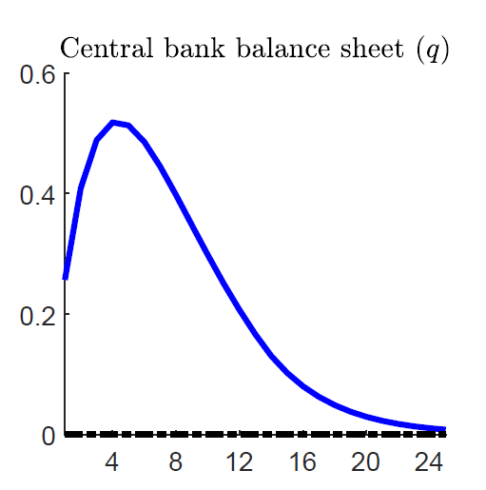
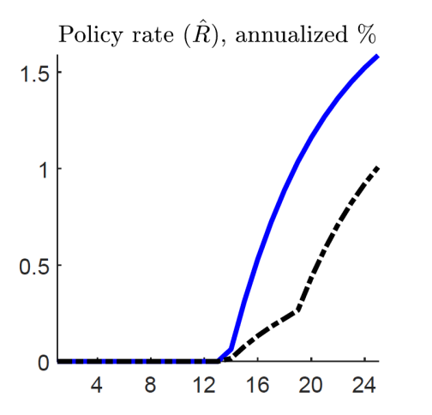
This paper: Optimal Policy
Away from the ZLB:
Only stock effects: no QE
Stock and flow effects: no QE in the long run if initial BS>0: reduce gradually (trade off negative flow and stock effects)
Optimal response to ZLB shock:
Rapid increase in BS.
Don’t increase all at once to reduce flow costs.
Start QT while still at the ZLB to reduce stock costs.
Liftoff before completing QT to minimize flow costs.
When starting from maximal balance sheet:
Similar (larger stock effects substitute for lower flow effects)

Slide 4
This paper
Great paper
Elegant, Simple, Intuitive
Speaks directly to many extremely policy relevant questions
Exit strategy ✓
QT response to cost push shocks !

Slide 5
Comment 1: Stocks, flows
Flow effects are larger then stock effects in baseline calibration
Theory: Contradicts macroeconomist’s intuition (Gertler and Karadi 2011, Vayanos and Vila 2021)
Empirics: Flow effects order of magnitude smaller (D’Amico and King 2013)

Slide 6
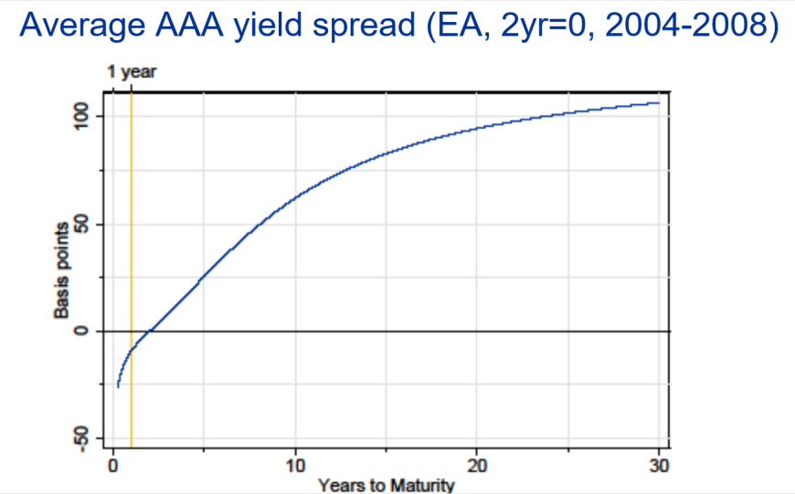
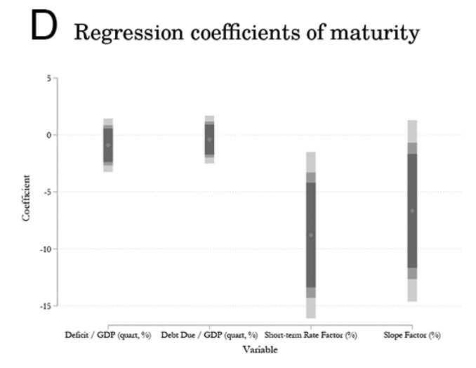
Comment 2: The cards are stacked against a large balance sheet
The private sector has preferences over the maturity structure of debt
The treasury provides the optimal maturity structure
No term premium, flat yield curve in SS
SS is first best
QE can only make things worse
Does empirical YC point to inefficiencies?
Greenwood, Hansen, Stein (2016)
The treasury does not respond to QE
(neither quantity nor maturity of debt)
Bigio, Nuno, Passadore (2023)
Large balance sheet may have other advantages:
generates fiscal revenues
increases liquidity
better operational control of short term rate
stabilizes risky sovereign debt

Slide 7
Minor comments
Unlike nominal interest rates, QE has real effects even with flex prices. How does this shape optimal policy in the context of a flat Phillipscurve?
ZLB constrains short rate, but no ZLB LT rate or on period return of LT bond. With QE, HH holds LT debt even though period return is negative.
Is QE like a tax on savings? Both make savings less attractive, but tax would have no welfare effects.
If solved globally, why solve the linearized model in the numerical part?
QE introduces a state variable because of flow effects
Section 3.2.3 claims that unbounded q makes q stop being a state, but that’s not formally true, because it appears also in the objective
Britain is a SOE. MP has FX effects. Model is closed economy, but calibrated to match British QE effects.
What explains the 2nd kink in the black policy rate in figure 5 (maybe colors are switched?)
Explanation why the two FIT policies are not equivalent could be clearer.
Editing:
Specify what you mean by welfare losses (relative to what) in intro.
Specify what z is on p. 9
Define Phi on p. 14
Explain D-notation on p. 17

